Slide 1

University Institute of Liberal Arts and Humanities
Course Name – Communication Skills
Course Code – 23PCH-105
Proofreading
DISCOVER . LEARN . EMPOWER

Slide 2
COURSE OBJECTIVES
The Course aims to:
1 | Augment students overall communication and interpersonal skills by making them realize the importance of good oral and written English Language in professional life.
2 | Enrich their reading capability with special emphasis on expanding vocabulary and grammatical formations.
3 | Build exceptional speaking, reading and writing skills by correcting grammatical errors and pronunciation through practice.
4 | Enhances soft skills by fostering self awareness, confidence and a positive attitude in students’ ability to communicate effectively in English.

Slide 3
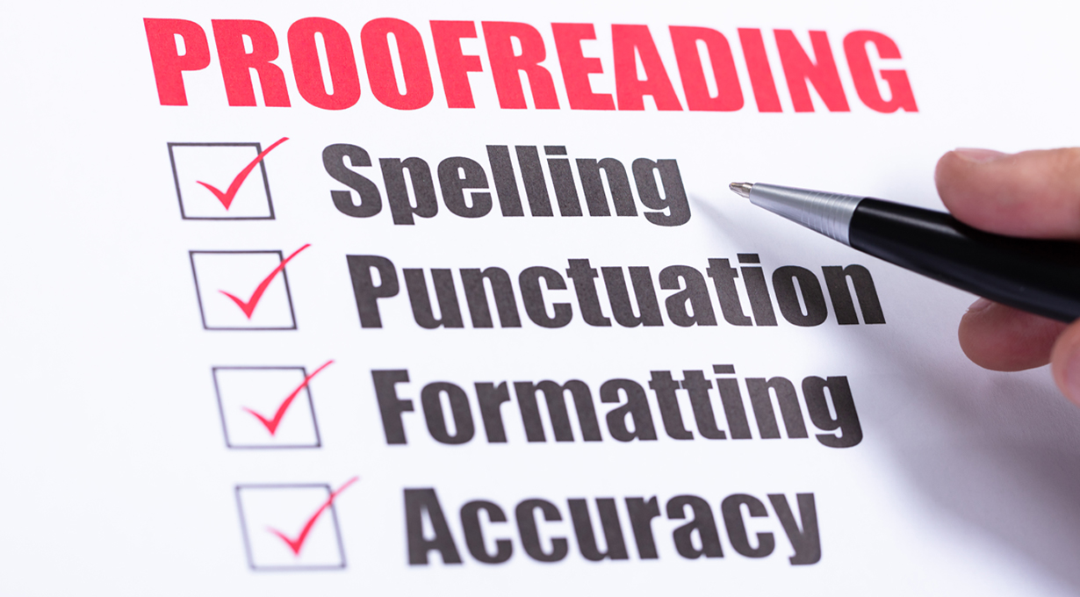
COURSE OUTCOMES
The students are expected to
CO Number | Title | Level
CO1 | Apply appropriate Listening, Speaking, Reading and Writing Skills (LSRW Skills) with correct non-verbal cues to attain expertise in soft skills. | Apply
CO2 | Apply correct contextual and comprehensible written text in the form of paragraph writing, short compositions business correspondence, using logical support and argument in a wide range of communication situations. | Apply
CO3 | Demonstrate linguistic competence while speaking and during presentations through accuracy in grammatical usage, vocabulary, pronunciation and intonation. | Apply
CO4 | Evaluate information as critical readers, speakers and writers applying ethics in communication and being sensitive in cross cultural communication. | Evaluate
CO5 | Create original, digital content for websites, blogs, vlogs and personal social media profiles etc. | Create
Wordpress.com

Slide 4
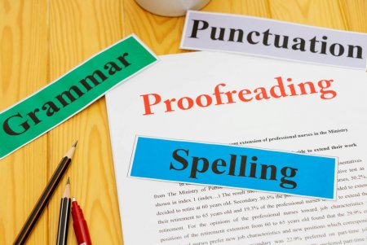
What is proofreading?
Proofreading is just as its name suggests- the reading of a proof to make any document error free.

Slide 5
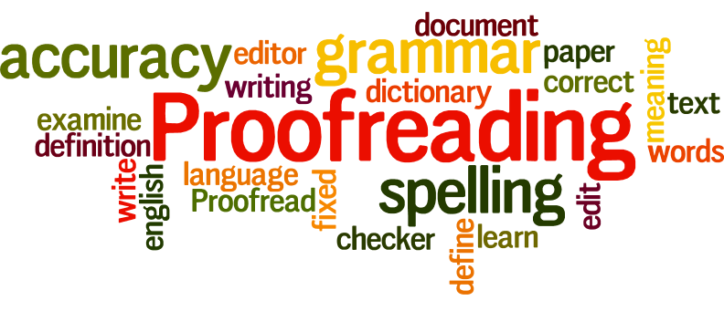
Why proofreading is important?
To ensure accuracy in grammar.
Consistency in spelling, punctuation and formatting.
Revision of a manuscript before it is printed or published.
To review the final draft.
Study.com

Slide 6

Why Proofreading is important? cont.
To see the final accurate version.
Get better grade on final paper.
Eradicate errors.
Avoid negative impression.
Give big picture view.
Achieve good results.
Include appropriate information.

Slide 7
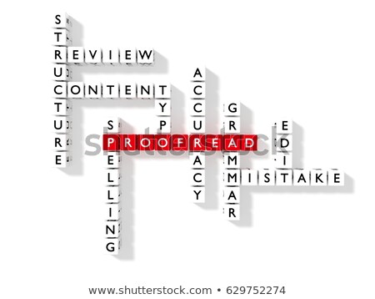
Measures to check the document-
Accuracy
Grammatical errors
Sentence framing
Spelling mistakes
Right words
Punctuations
Cohesion-Coherence

Slide 8
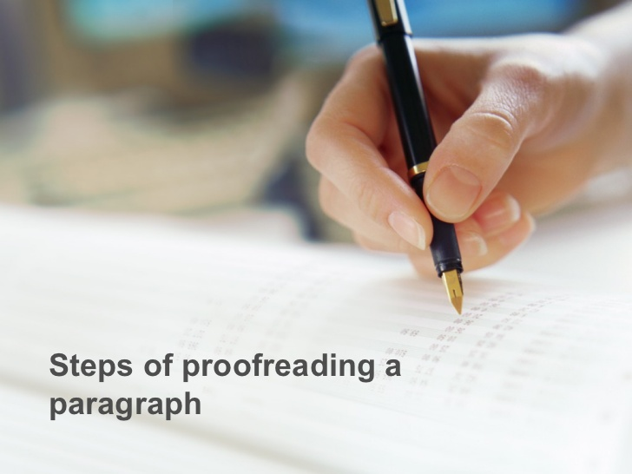
Steps of proofreading-

Slide 9
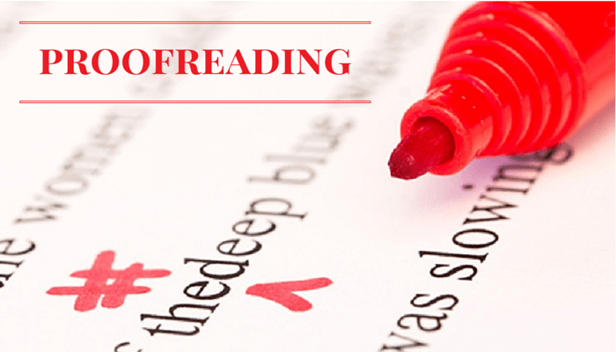
Steps of proofreading-
Use a checklist
Fact-check
Spell-check
Read aloud
Focus on one line at a time
Attend to format
Proof again

Slide 10
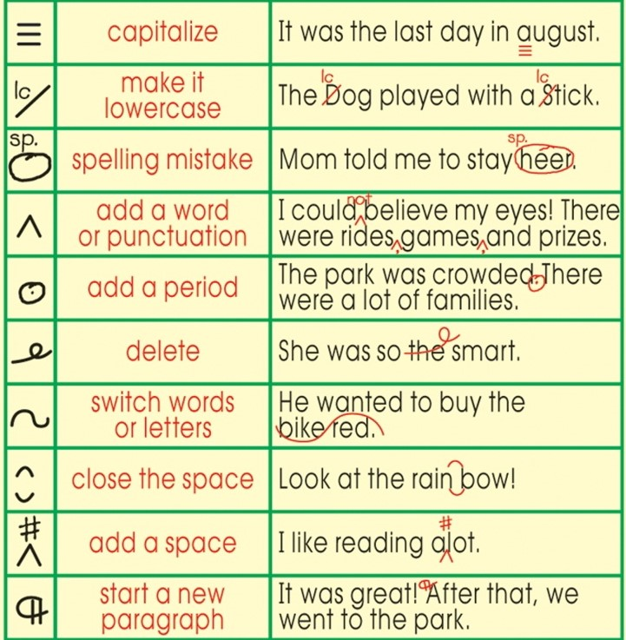
Use of symbols with examples-

Slide 11
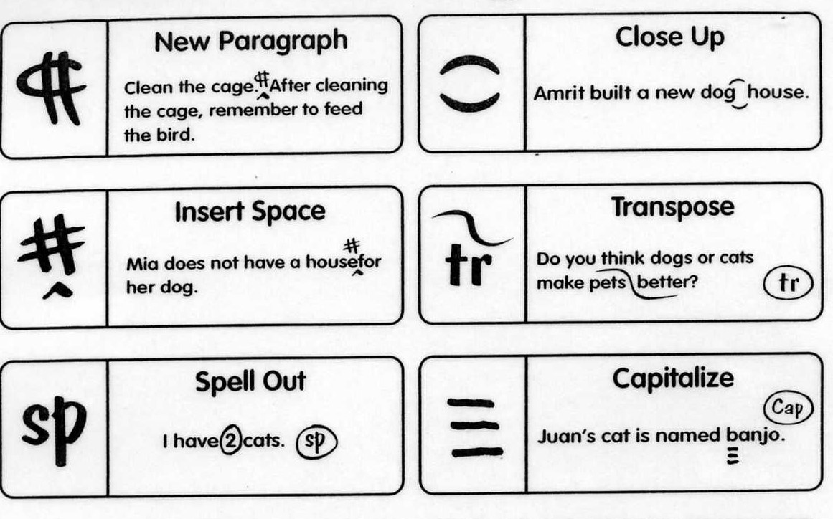
Use of symbols with examples-

Slide 12
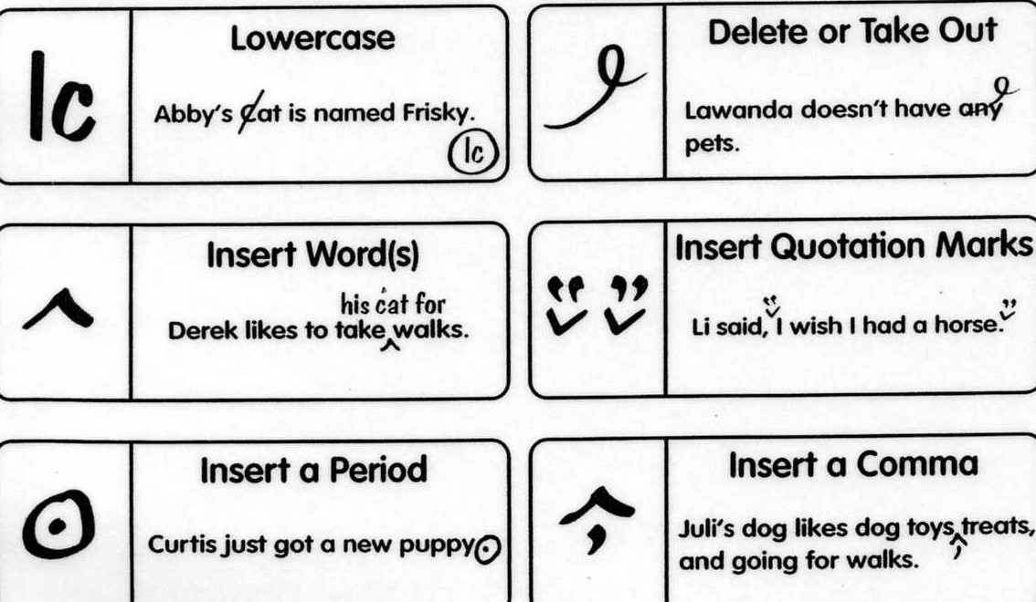
Use of symbols with examples-

Slide 13
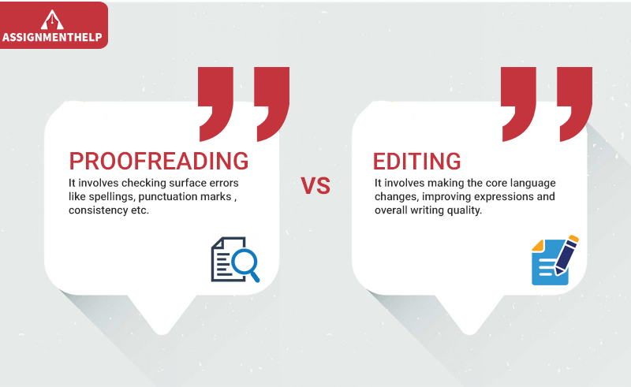
Proofreading Vs Editing -

Slide 14
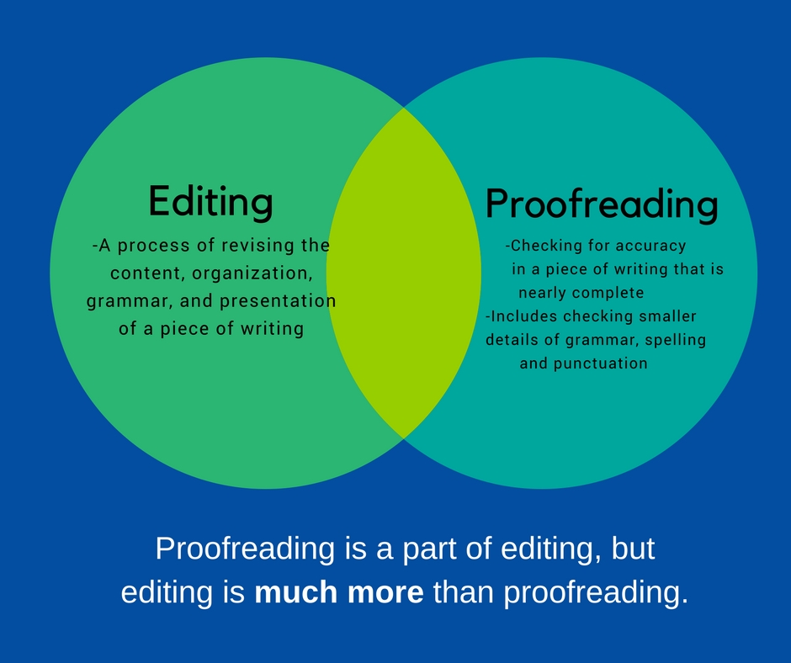
Proofreading Vs Editing -

Slide 15
The differences are actually pretty simple to understand once they are explained. They can be summed up in two sentences:
“Copyeditors catch all the mistakes the author missed,
Proof-readers catch all the mistakes the copyeditor missed.”

Slide 16

Qualities of a good proof-reader-
Knowledge
Focus
Passion for accuracy
Patience
Ability to be meticulous

Slide 17
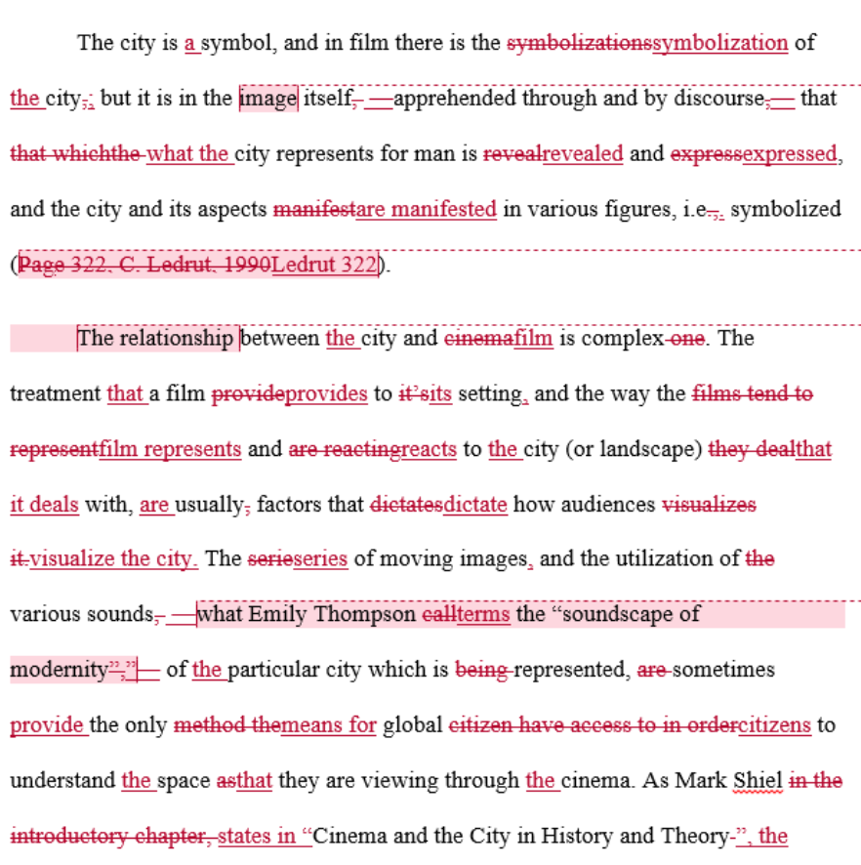
Example of editing and proofreading

Slide 18
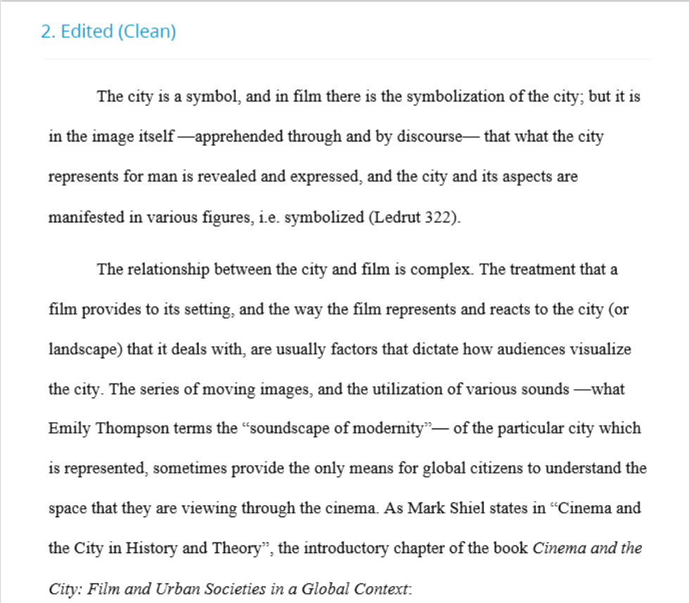
Edited work -

Slide 19
Applications
Proofreading helps to improve the writing efforts of students as they skip this crucial step when writing.
It creates readable writing and eliminates errors before printing or submitting an academic paper, essay, email or any other written document.

Slide 20
Assessment Pattern
Students are assessed on the basis of the following parameters:
Hourly Test-2
Assignments
Surprise Test
Quiz
End Semester Exam

Slide 21
References
https://www.bookbutchers.com/
https://experteditor.com.au/book-proofreading/
https://r.search.yahoo.com/_ylt=AwrxgvkQJeNe5ScAxQrnHgx.;_ylu=X3oDMTByajVjNzRjBGNvbG8Dc2czBHBvcwM0BHZ0aWQDBHNlYwNzcg--/RV=2/RE=1591973264/RO=10/RU=https%3a%2f%2fwww.scribendi.com
-book_proofreading/RK=2/RS=CebHxO10hY_FDhzAAKCozjxiCVE-

